Slide 1
Forest Sound-Track
MakeZurich Vol.II

Slide 2
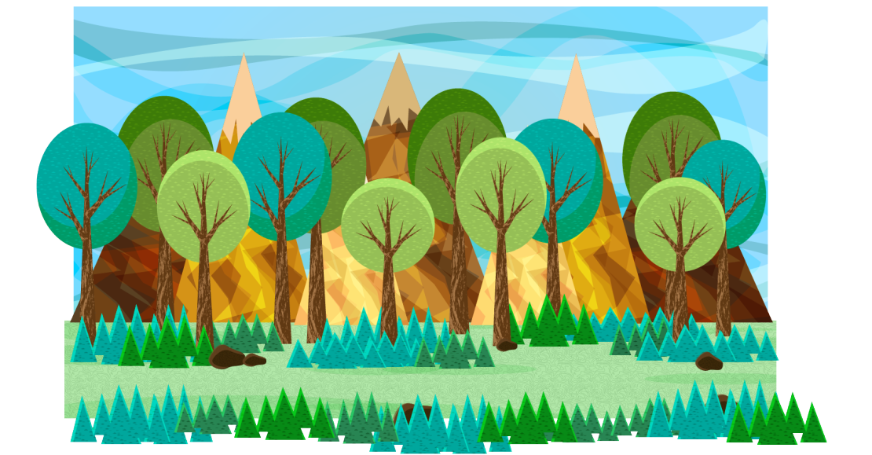

Slide 3



Slide 4
Schools/Research
Parks and Opening Space Planning
Bird Watchers
etc

Slide 5



Slide 6
Alert to user’s device
Which bird?
Where?
When?

Slide 7
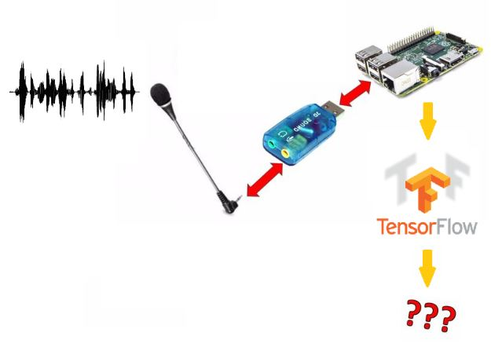
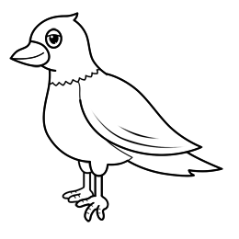
Forest Sound-Track
Oleg Lavrovsky, Afsoon Ebrahimi

